Slide 1
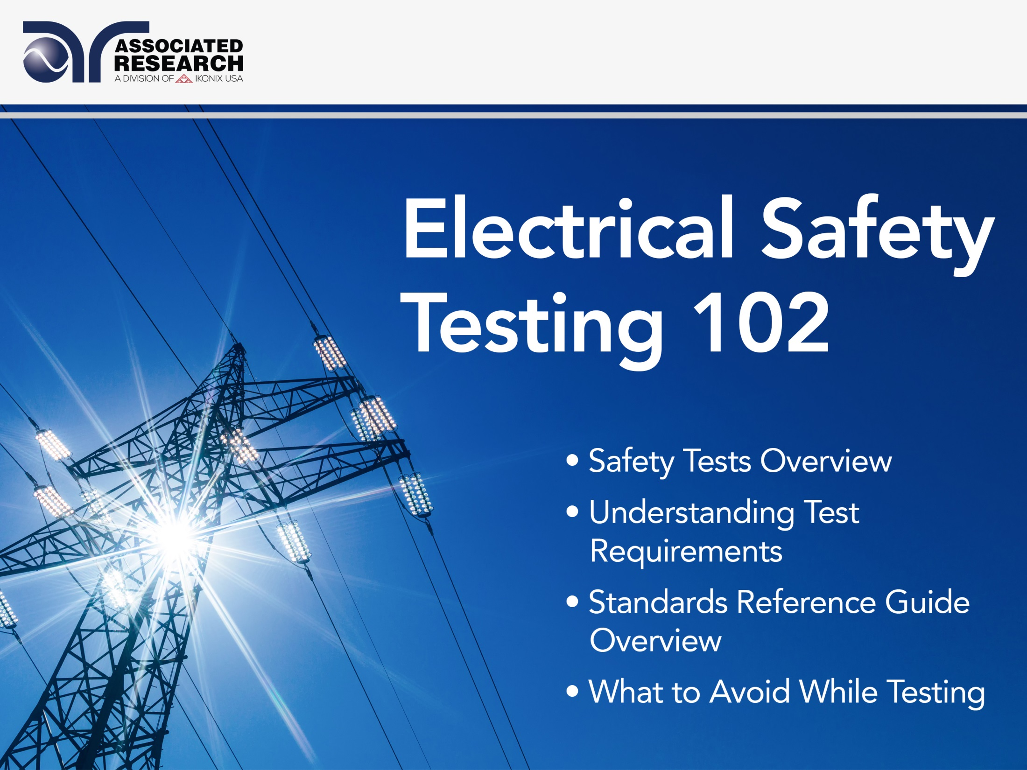

Slide 2


Slide 3
Webinar Notes
Please use the Q & A utility to ask us any questions concerning the material being presented.
Any questions related to running of the meeting (audio and visual, etc.) can be addressed to the host, Brittany Socha, through the chat line.
The webinar is being recorded and will be available to view usually within a day on our website arisafety.com/webinars
Please contact Brittany Socha – on the chat line or email brittany.socha@arisafety.com if you would like a copy of this presentation.

Slide 4
Learning Objectives
Safety Tests Overview
Understanding Test Requirements
Standards Reference Guide Overview
What To Avoid While Testing

Slide 5

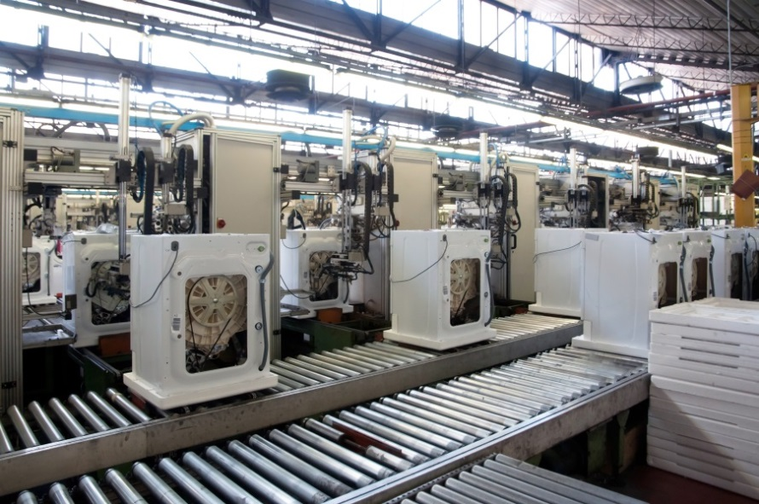
Type Vs. Routine Test
Type Test | Routine Test
Prototype Testing | 100% Final Product Testing
Laboratory Environment/Conformance Testing | Production Line Testing After Final Assembly

Slide 6
Type Tests
Conducted at the engineering level on sample product.
Conducted by manufacturer and the safety agency.
Safety Standards are designed to ensure product safety.
Type tests verify the design integrity of a product.
Type tests are more rigorous than production line tests.
Notes:
Conducted at the engineering level.
Conducted on samples of a product.
Conducted by manufacturer and the safety agency.
Objective is to determine if a product, as designed and manufactured, meets the requirements of the standard.
Safety Standards are designed to ensure product safety.
Type tests verify the design integrity of a product.
Type tests are more rigorous than production line tests.

Slide 7
Routine Tests
Performed on each product at the end of production line or fully assembled products.
Designed to ensure safety of the end user of the product.
Dielectric Withstand, Ground Continuity/Ground Bond tests are commonly specified as 100% routine tests.
Additional tests may be specified as routine tests by the manufacturer and the safety agency to guarantee acceptable level of compliance with safety standards.
Notes:
Performed on each product at the end of production line.
Performed by the manufacturer on fully assembled products.
Designed to ensure safety of the end user of the product.
Dielectric Withstand, Ground Continuity/Ground Bond tests are commonly specified as 100% routine tests.
Depending on the type of product, additional tests may be specified as routine tests by the manufacturer and the safety agency to guarantee acceptable level of compliance with safety standards.

Slide 8





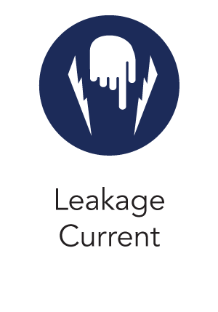
Common Electrical Safety Tests

Slide 9
Poll Question
Which Electrical Safety Tests does your organization experience the most obstacles with?

Slide 10
Ground Continuity Test
Verifies a connection between exposed conductive parts and the ground of the power cord on the product under test.
Routine production line test conducted on Class I products.
A low current DC signal is applied from the chassis of the product to the ground pin.
Notes:
Verifies a connection between exposed conductive parts and the ground of the power cord on the product under test.
Routine production line test conducted on Class I products.
A low current DC signal is applied from the chassis of the product to the ground pin.
Typically performed at a current under 1A to check that the ground connection is continuous.

Slide 11
Ground Bond Test
GB test verifies the integrity of the ground connection between exposed metal and ground wire of the power cord.
High current is injected into the ground pin of the product’s power cord which flows through the chassis.
Determines if the safety ground wire is capable of handling excessive current flow in case a fault occurs and the product’s insulation fails.
Notes:
If a Ground Bond test is performed, Ground Continuity test is not necessary.

Slide 12
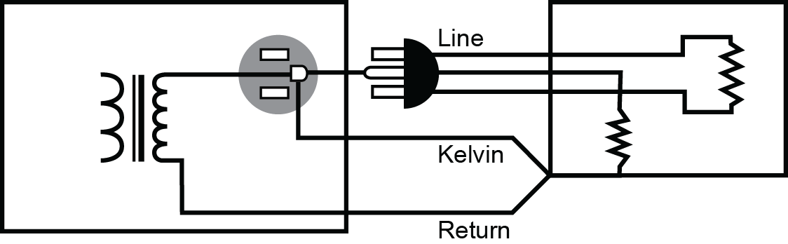
Ground Bond Test
Circuit for Ground Bond Test.

Slide 13
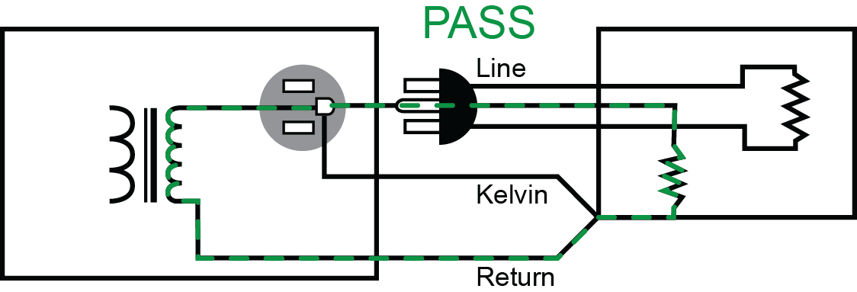
Ground Bond Test

Slide 14
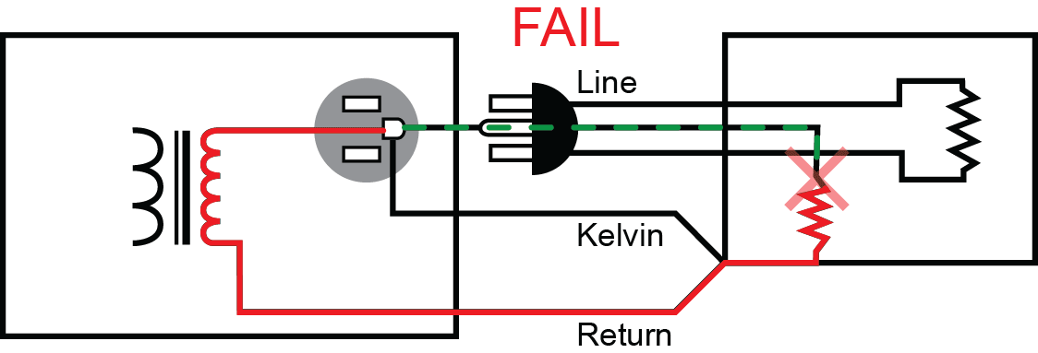
Ground Bond Test

Slide 15
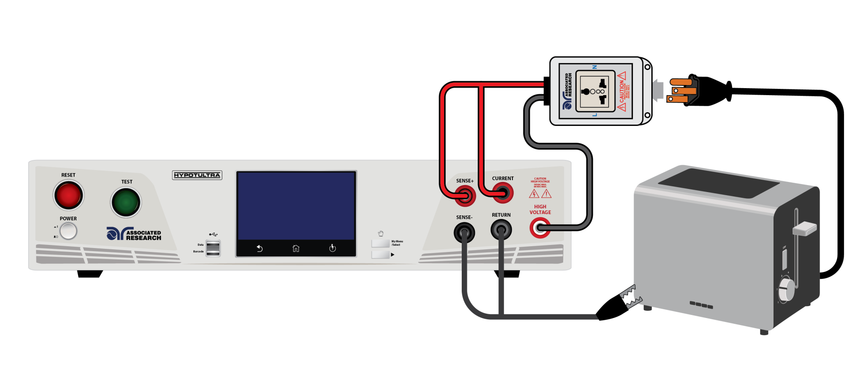
Ground Bond Test
Ground Bond test is commonly considered a Type test and is generally performed before the Hipot test
The results of this test are displayed in Ohms (Ω).
The ground conductor of a product must have a low enough impedance to handle any fault current.

Slide 16
Ground Bond Test
Test parameters for Ground Bond test vary from standard to standard.
Manufacturers must consult the safety standard which they are trying to comply with before setting test parameters.
For example, UL 60950 IT Equipment (Type Test) calls out for the test current to be twice the fuse rating of the product or twice the current rating of the circuit under test.
Test voltage is not to exceed 12V and the duration of the test to be 120 seconds.
Notes:
Test current could be AC or DC based on the product and the safety standard.

Slide 17

Video Demo of GB and GC

Slide 18
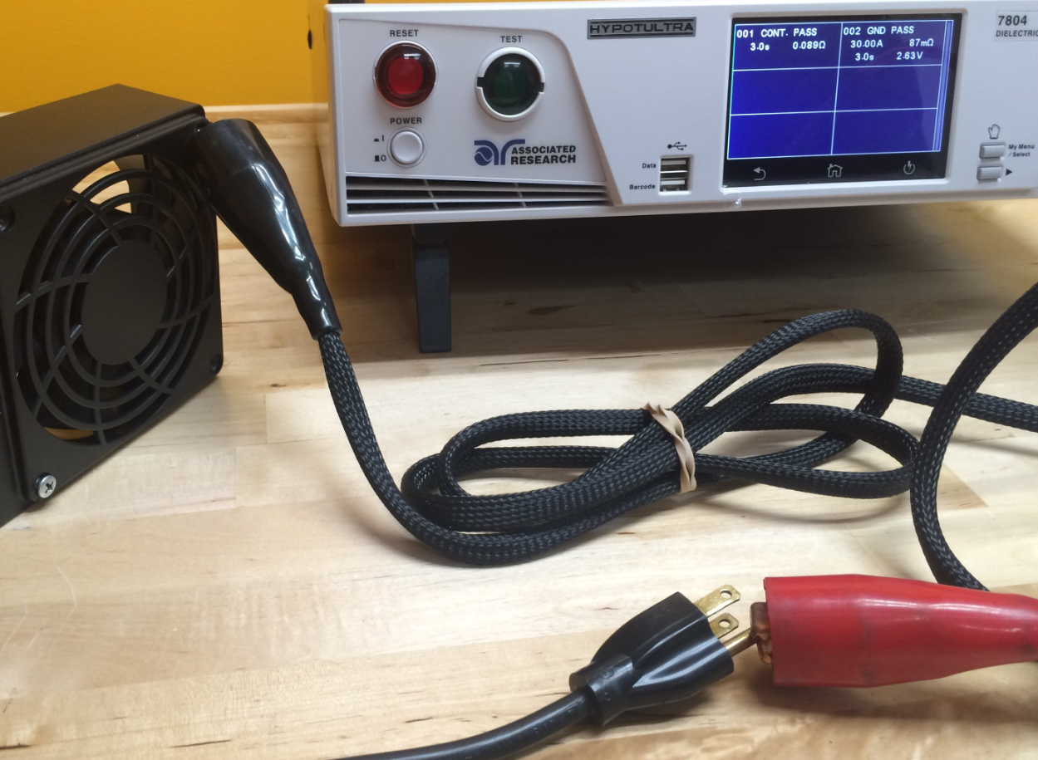

Slide 19


Ground Bond vs. Ground Continuity
Ground Continuity Test | Ground Bond Test
• Verifies the existence of a ground connection • Readings generally given in mΩ • The test is quick to set up and easy to perform • Usually used as an extra feature during the Hipot test | • Verifies the integrity of a ground connection • Readings generally given in mΩ • Provides more valuable safety information about DUT • Can be combined with a Hipot test for a more complete safety testing system
*The Ground Bond test is more stringent than the Ground Continuity test.

Slide 20
Dielectric Withstand Test
Also referred to as Hipot test, it is used to determine whether the insulation of a product is able to withstand an over-voltage condition for a period of time without breaking down.
It is a deliberate application of high voltage potential between the mains input and any exposed dead-metal.
The resulting leakage current (due to the application of high voltage) is measured to determine whether a product’s insulation is able to withstand the high voltage without breaking down.
This test verifies that the insulation of a product is capable of protecting the user from any leakage currents as a result of an electrical fault within the product.

Slide 21
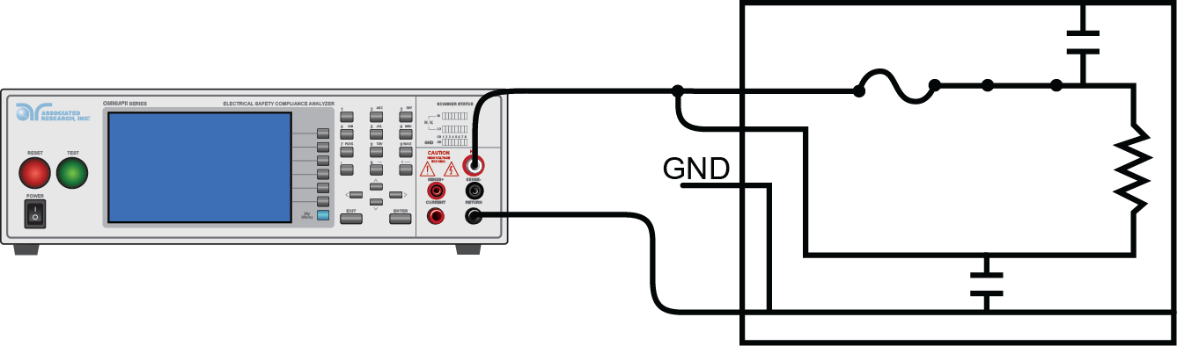
Dielectric Withstand Test
Can be a Type test or a Routine test.
Used to detect possible defects in the design of a product and workmanship defects such as inadequate creepage and clearance distances.

Slide 22
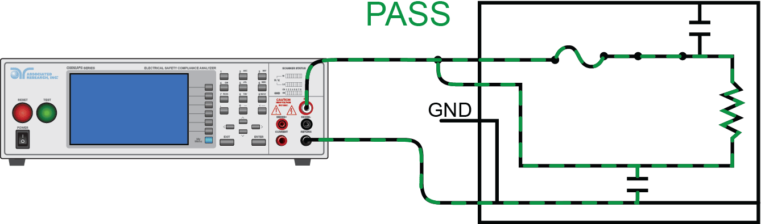
Dielectric Withstand Test

Slide 23
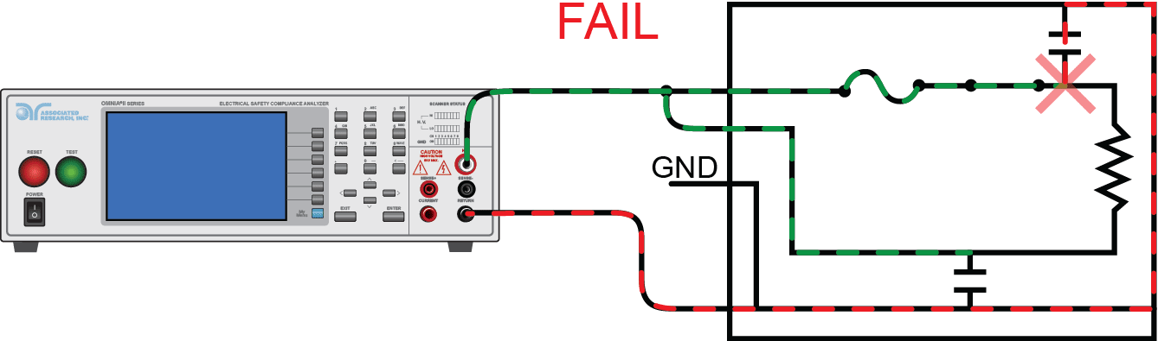
Dielectric Withstand Test

Slide 24
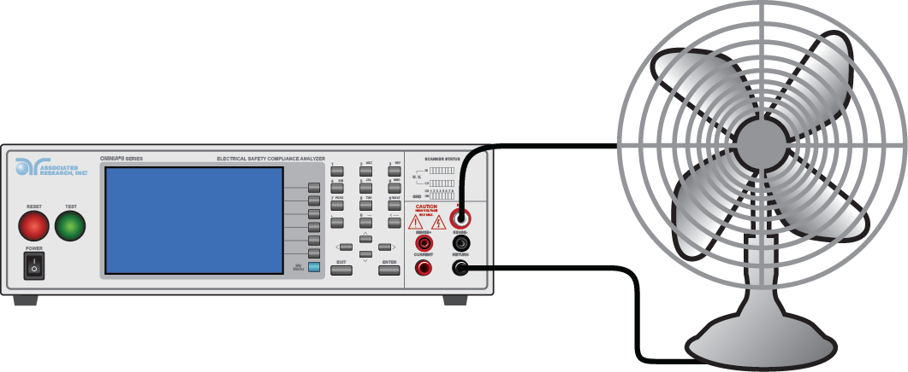
Dielectric Withstand Test
Leakage current is present in every product to some degree.
Leakage current becomes a problem when it reaches excessive levels due to dielectric breakdown.
Result is displayed in mA or µA depending on test type.

Slide 25
Dielectric Withstand Test
Test is performed on both Class I and Class II products.
Test can be performed in both AC and DC mode based on the safety standard, however AC hipot test is more stressful than the DC hipot test.
Test voltage and trip settings must be specified by the manufacturer in accordance with the safety standard.
Most standards specify the test voltage to be calculated using the following formula: 2 x Products Rated Voltage plus 1000V

Slide 26
Insulation Resistance Test
Similar to a DC Dielectric Withstand Test.
Stresses the same insulation on a product as the hipot test.
Provides a quantifiable value of the product’s insulation in a resistance measurement .
Commonly performed on serviced and repaired units to verify product integrity.
Most standards specify test voltage at 500 or 1000 Volts.
Notes:
Hence, the least commonly specified electrical safety test.
High insulation resistance value indicates good insulation.

Slide 27
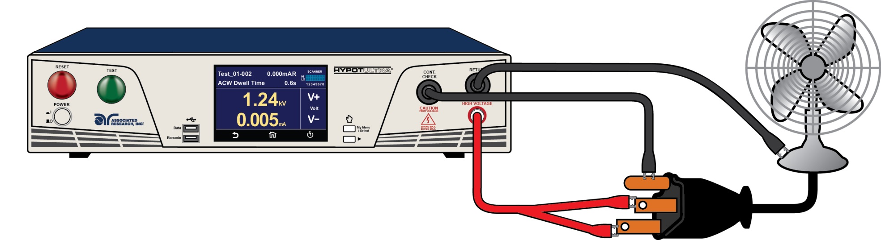
Insulation Resistance Test
Like other electrical safety tests, test parameters vary upon the standard.
EN 60204-1 Safety Of Machinery, specifies a 500V DC test between the power circuit conductors and protective bonding circuit, the resistance shall not be less than 1MΩ.

Slide 28
Video Demo of ACW, DCW & IR

Slide 29
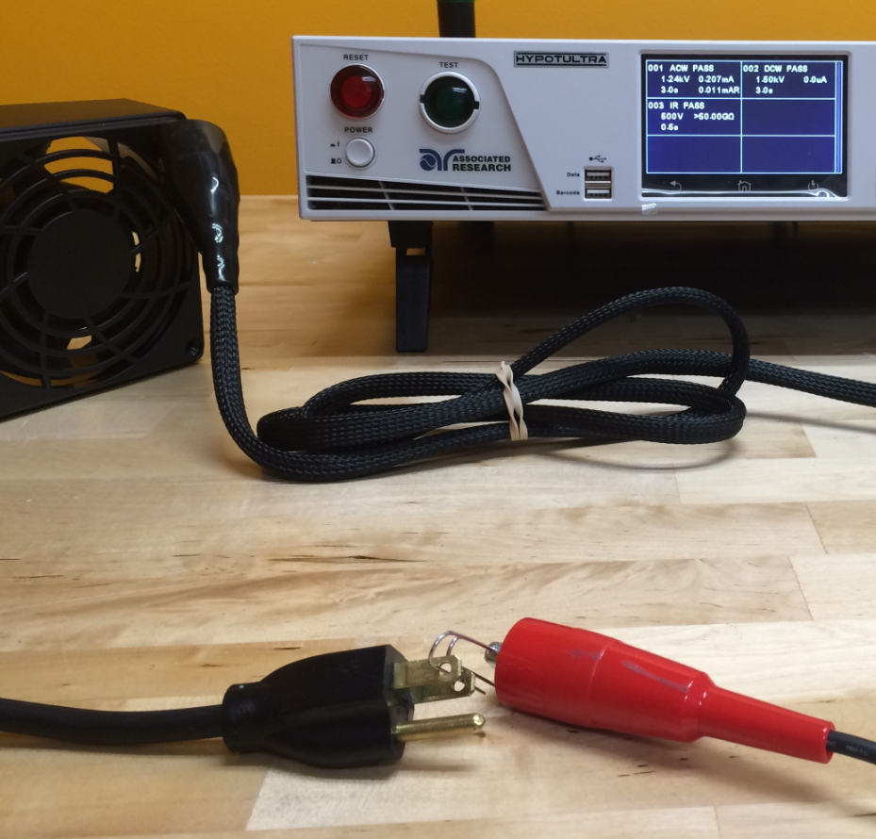
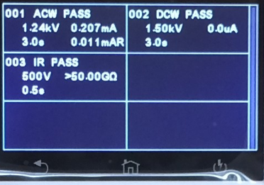

Slide 30
Leakage Current Test
Line Current Test are performed on electrical products to measure the leakage current which could flow through a person while the product is operating.
A measuring device (MD) is used to simulate the impedance of the human body under different conditions depending upon the application of the product.
Test is run under both normal and single fault conditions and reversed polarity on the input line power at 110% of rated input.
Most commonly performed on medical equipment.

Slide 31
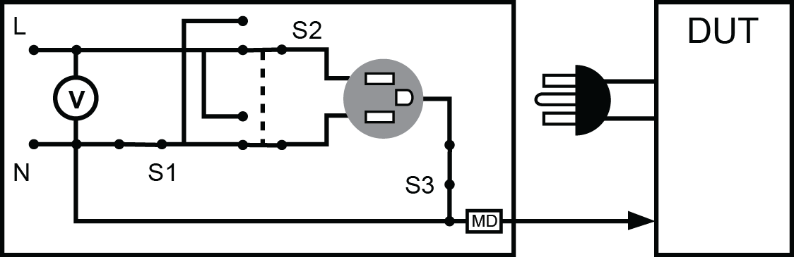
Leakage Current Test
Typical circuit for Leakage Current test

Slide 32
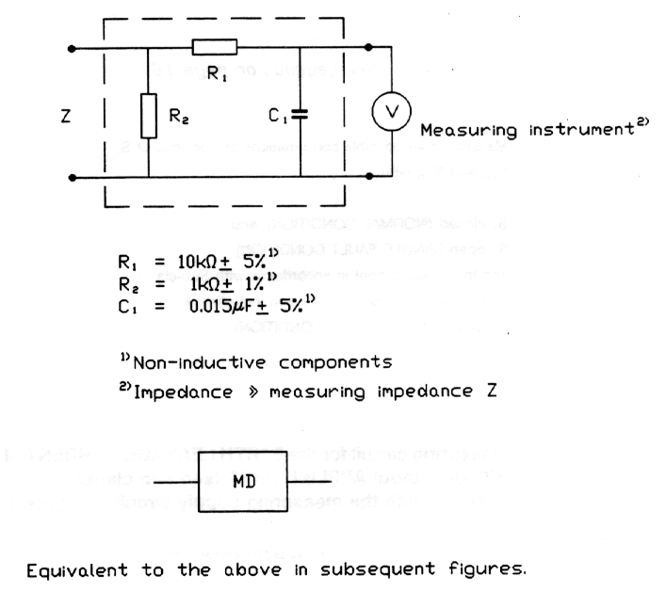
Leakage Current Test
The MD can vary from standard to standard.
Measuring device for EN 60601-1 Medical Electrical Equipment.

Slide 33

Questions?
Submit Questions through the Chat Box

Slide 34
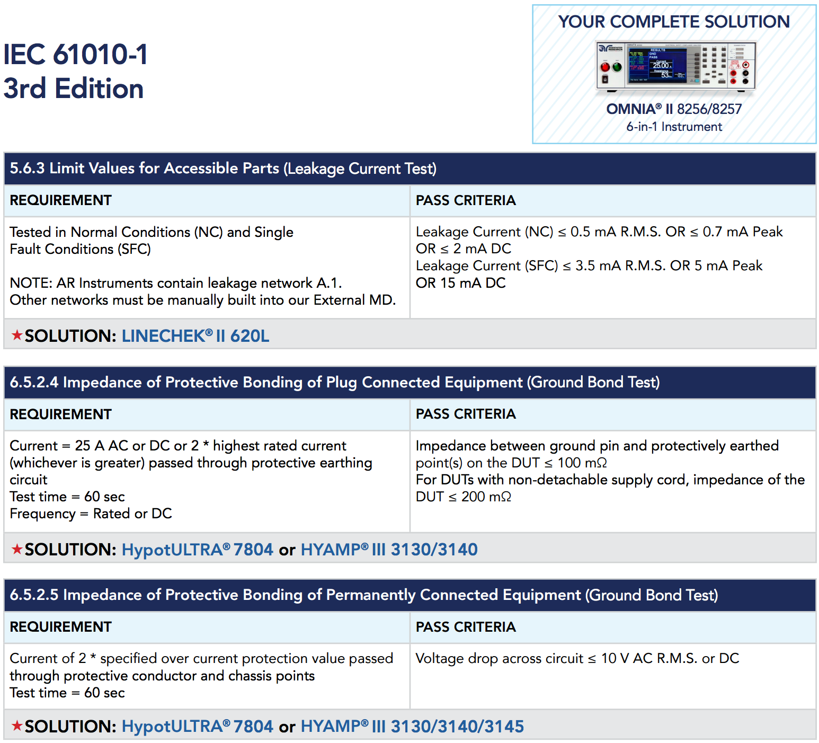

Slide 35
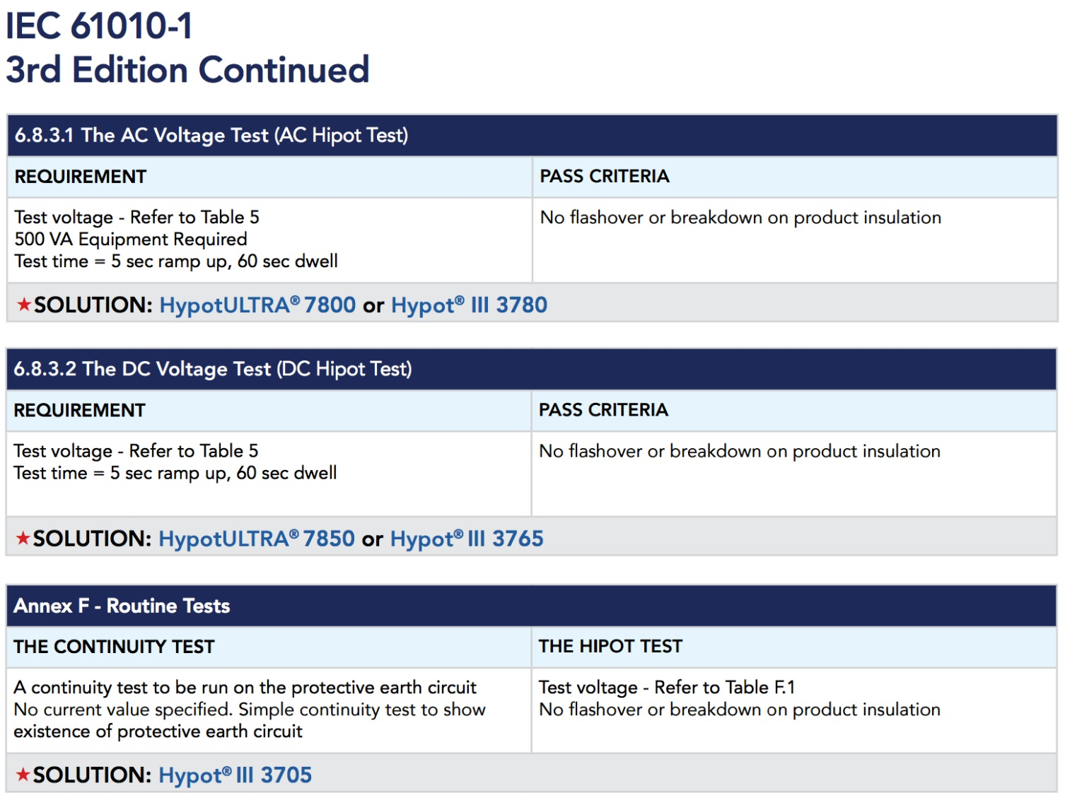

Slide 36
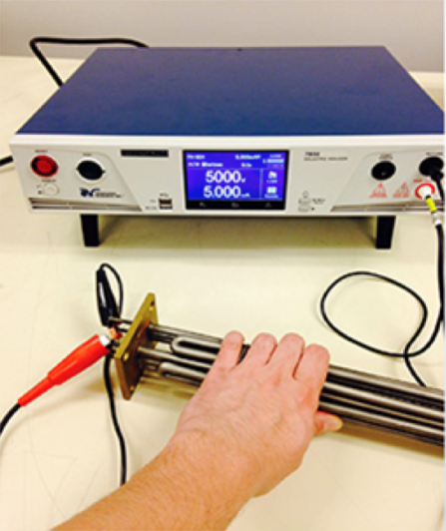
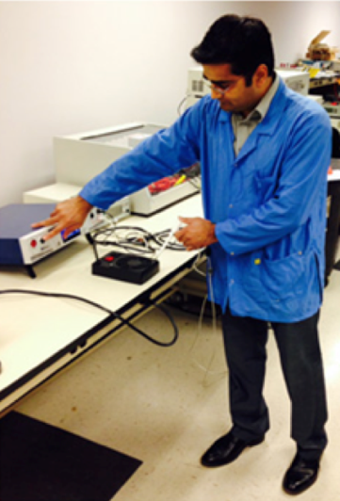
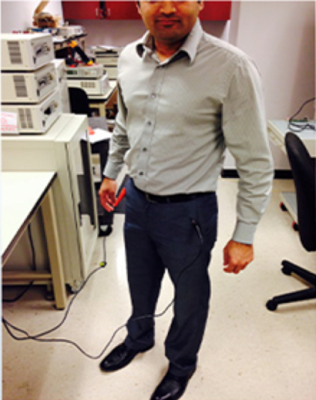

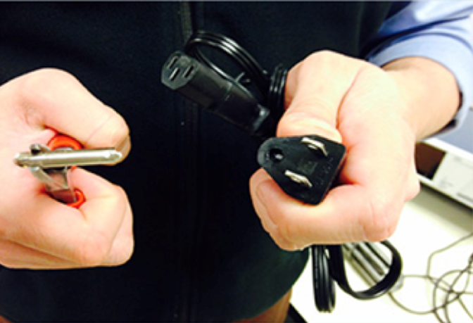
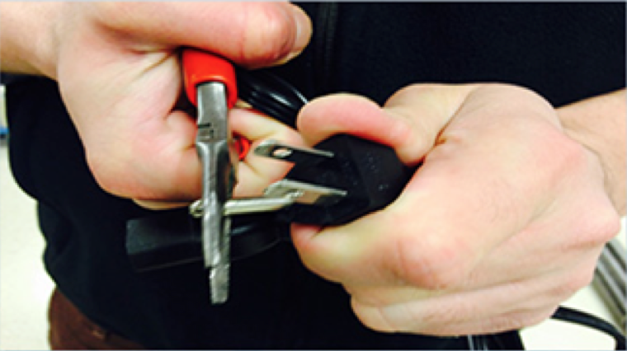
What to AVOID When Testing
Touching DUT During Test
ESD Smock
Touch Test Leads During Test
Broken Ground Pin
Breaking Ground Pin On Test Equipment

Slide 37
What to AVOID When Testing
Do not attempt to perform tests on a product that are not meant to be performed for that product.
Do not attempt to use a testing device if not familiar with it.
Do not attempt to power up a test device with an unknown power source or outlet.
Do not assume anything about the functionality of a test device. Always read the manual.

Slide 38
What to AVOID When Testing
Do not attempt to perform any electrical safety tests in or around ESD test areas..
Do not cover or block the ventilation slits during operation.
Do not replace the power supply cord with an improperly rated cord.
Do not attempt to defeat the protective ground on the power cord by using an extension cord without a protective conductor.

Slide 39
What to AVOID When Testing
Grounding the test operator could lead to harmful or fatal electric shock.
Do not use accessories that are not approved by the manufacturer.
Do not disconnect any test leads while the test is running.
Do not attempt to use the tester in environmental conditions that are beyond the specifications of the tester.

Slide 40
Questions?

Slide 41

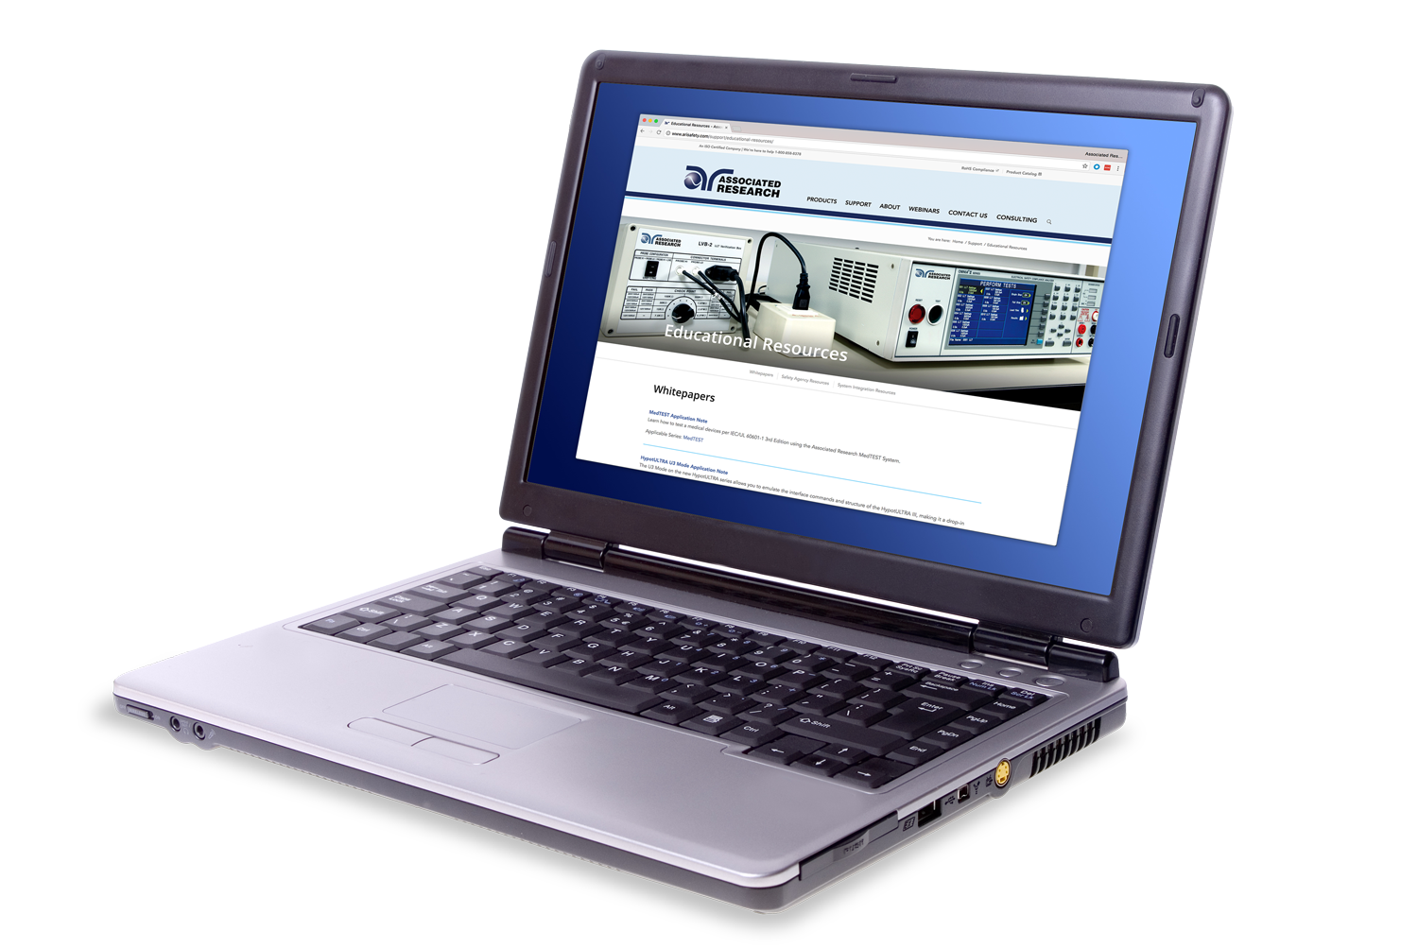
Resources
Visit us online to view all of our Educational Resources:
http://www.arisafety.com/support/educational-resources/

Slide 42
Join us for our Next Webinar
Electrical Safety Testing Circuit Theory
Wednesday, April 13th at 10 A.M. CST

Slide 43

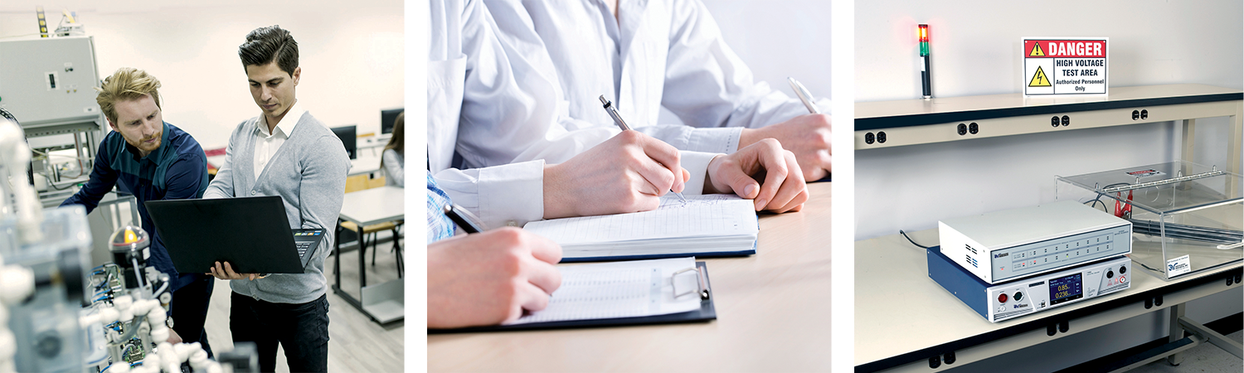
Need One-On-One Assistance with your Application?
Nobody understands electrical safety testing better than we do.
Overcome challenges and mitigate risks on the production line and in the laboratory
Safety Standard Analysis
Safe and Effective Test Setups
For more details email applications@arisafety.com or call +1-847-367-4077

Slide 44

Contact Us
If you would like a copy of this presentation please email Brittany Socha at brittany.socha@arisafety.com
Check out our website for more information arisafety.com

